Slide 1
PASSING ARGUMENTS:
REFERENCES AND VALUES
TLDR:
Arguments may be passed by either value or reference value
The mode depends on the argument class

Slide 2
PART 0:
CLASSES OF DATATYPES
TLDR:
2 classes - Primitives and Non-Primitives

Slide 3
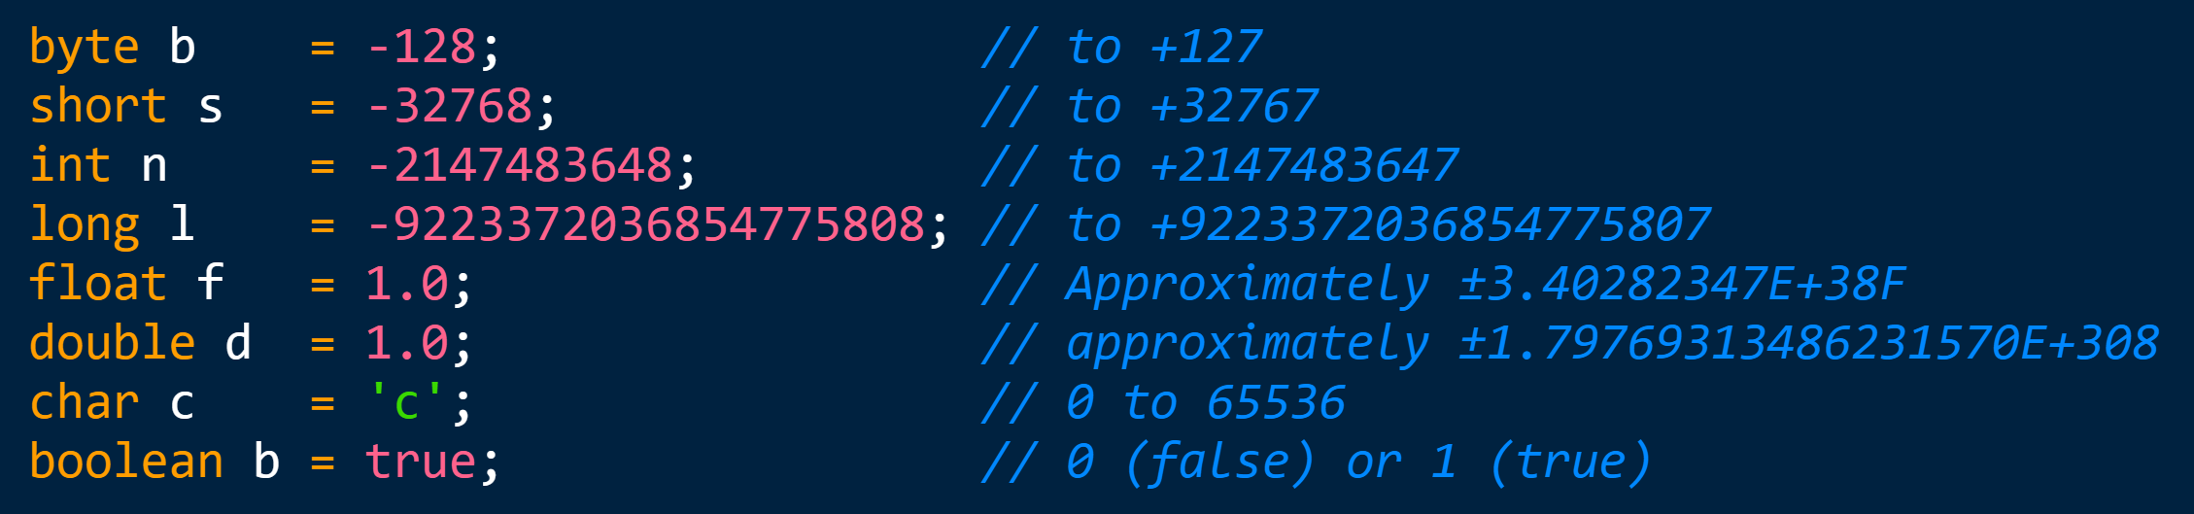
PART 0: DATATYPES
2 classes of data:
PRIMITIVES:
NON-PRIMITIVES:
(Literally everything else)
Composite types, reference types, compound types, class types...
Notes:
Now that we have our array, let's write to the first bucket! We're literally telling the program, "Hey anArray, assign '100' to your 0th bucket."
The picture in memory now looks something like this:

Slide 4
PART 1:
METHOD STRUCTURE
TLDR:
3 pieces relating to argument passing:
1) Arguments
2) Local Variables
3) Return

Slide 5
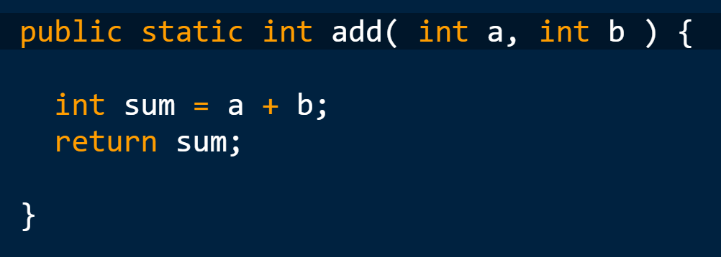
PART 1: METHOD STRUCTURE
A basic method 'add()' which sums two numbers
ARGUMENTS
LOCAL
VARIABLE
RETURN VALUE
Notes:
Now that we have our array, let's write to the first bucket! We're literally telling the program, "Hey anArray, assign '100' to your 0th bucket."
The picture in memory now looks something like this:

Slide 6
PART 1: METHOD STRUCTURE
ARGUMENTS - 'Passed in' from caller
- Can be referenced and worked on in scope
LOCAL VARIABLES - Declared in the method 'scope'
- Disappears if the method goes out of scope
- Can't be seen outside the method except by...
RETURN VALUE - The standard way to get information out of a method
- Can only send back one argument at a time
Notes:
Now that we have our array, let's write to the first bucket! We're literally telling the program, "Hey anArray, assign '100' to your 0th bucket."
The picture in memory now looks something like this:

Slide 7
PART 2:
METHODS AS A RELAY RACE
TLDR:
Accurate metaphor if both runners hold a baton
Argument must be transferred across batons at calls and returns

Slide 8
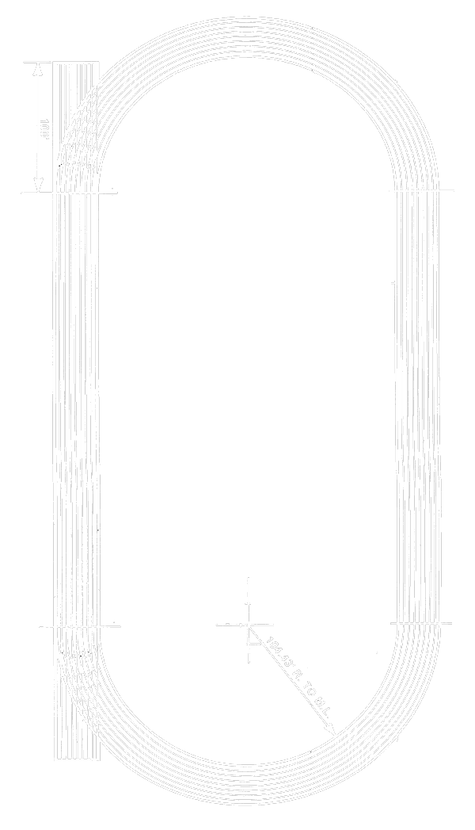


PART 2: THE METAPHOR
ARGUMENT(S)
RETURN
CALLER
METHOD
METHOD
CALLER
Notes:
A common bug occurs if you attempt to access the last element but neglect this offset.
It's compounded because the program will usually happily read and write until it reaches the last element.
At that point, attempting to read index [10] on a size (10) array will cause an out-of-bounds error. It's important to note that this off-by-one error ONLY manifests itself beyond the last and final index.

Slide 9

PART 2: TWO EXAMPLES
public static void change( int i ) {
i = 5678;
}
public static void main( String args[] ) { int i = 1234;
change( i );
System.out.println( i );
}
public static int change( int i ) {
i = 5678;
return i;
}
public static void main( String args[] ) { int i = 1234;
i = change( i );
System.out.println( i );
}
CONSOLE:
CONSOLE:
1234
5678
RELAY METAPHOR APPROVED!

Slide 10
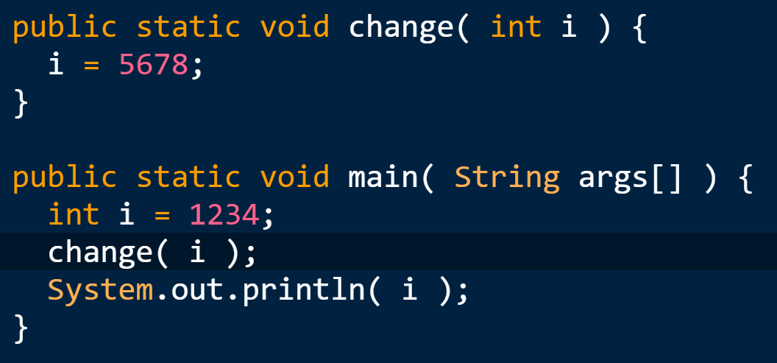
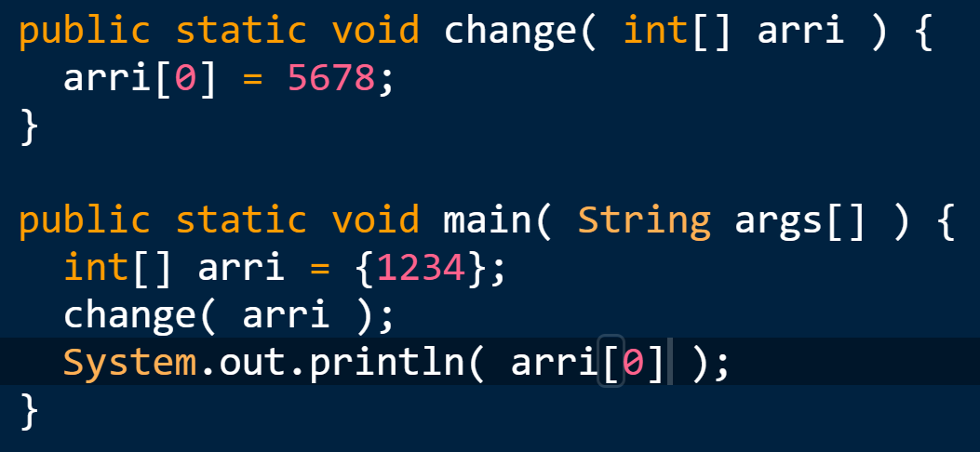
PART 2: TWO EXAMPLES
CONSOLE:
CONSOLE:
1234
5678

Slide 11

PART 2: THE METAPHOR - THE FIX
Thanks! Let me just copy your notes to mine...
ARGUMENT(S)
This is known as a 'pass by value'
- Caller keeps their own variable
- Method creates a new variable
- Argument is copied to method variable
- Method uses its own copy
CALLER
METHOD
Notes:
A common bug occurs if you attempt to access the last element but neglect this offset.
It's compounded because the program will usually happily read and write until it reaches the last element.
At that point, attempting to read index [10] on a size (10) array will cause an out-of-bounds error. It's important to note that this off-by-one error ONLY manifests itself beyond the last and final index.

Slide 12
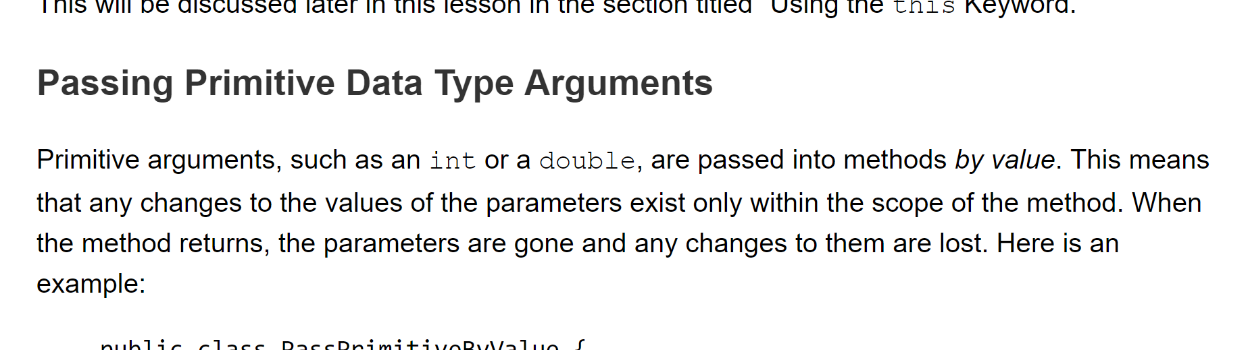
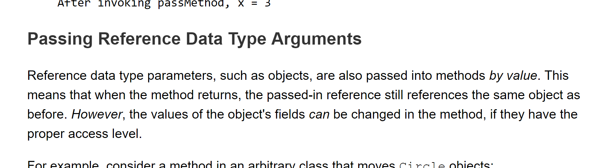
PART 2: THE METAPHOR
This works for all primitives!
https://docs.oracle.com/javase/tutorial/java/javaOO/arguments.html
Notes:
A common bug occurs if you attempt to access the last element but neglect this offset.
It's compounded because the program will usually happily read and write until it reaches the last element.
At that point, attempting to read index [10] on a size (10) array will cause an out-of-bounds error. It's important to note that this off-by-one error ONLY manifests itself beyond the last and final index.

Slide 13
PART 3:
NON-PRIMITIVES
TLDR:
Actually the same as with primitives
What's on the baton is tricksy - a reference (by value)

Slide 14


PART 3: NON-PRIMITIVES - INT[ ]
ARGUMENT(S)
CALLER
METHOD
ARGUMENT(S)
CONSOLE:
5678
CALLER
METHOD

Slide 15

PART 3: NON-PRIMITIVES - THE PASS
How large can a non-primitive data object be?
In the case of an 'int' array:
(~INT_MAX indices) x (4 bytes per index)
==
~8 000 000 000 bytes (8 GB)
FUN FACT:
If a 4 byte baton weighed 50 grams, a 2.147 billion long int array would have a mass of about 850 metric tons - equivalent to 2 fully loaded 747 jumbo jets.
8 GB

Slide 16


PART 3: NON-PRIMITIVES - 'LARGE' OBJECTS
How to efficiently handle large objects?
How about if we park the object somewhere else and just make note of its location?
This strategy is known as 'referencing'
ARGUMENT
(A TYPE OF REFERENCE)
CALLER
METHOD

Slide 17
PART 3: NON-PRIMITIVES - REFERENCE BY VALUE
So what, exactly, are we passing as an argument?
A VALUE!
Of a reference.
reference r = ???;
// The spooky 9th primitive!
CALLER
METHOD

Slide 18
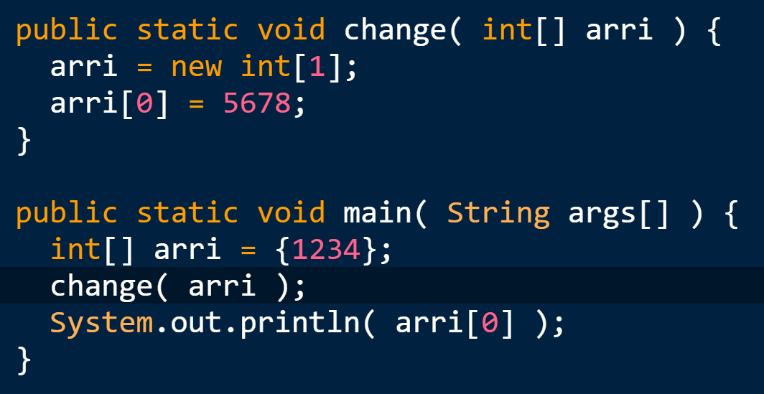
PART 3: NON-PRIMITIVES - REF BY VALUE PASS
CONSOLE:
CONSOLE:
5678
1234
Change rendered at relayed location.
All checks to the location show the change.
Change rendered to a new location.
Checking old location does not show change.

Slide 19

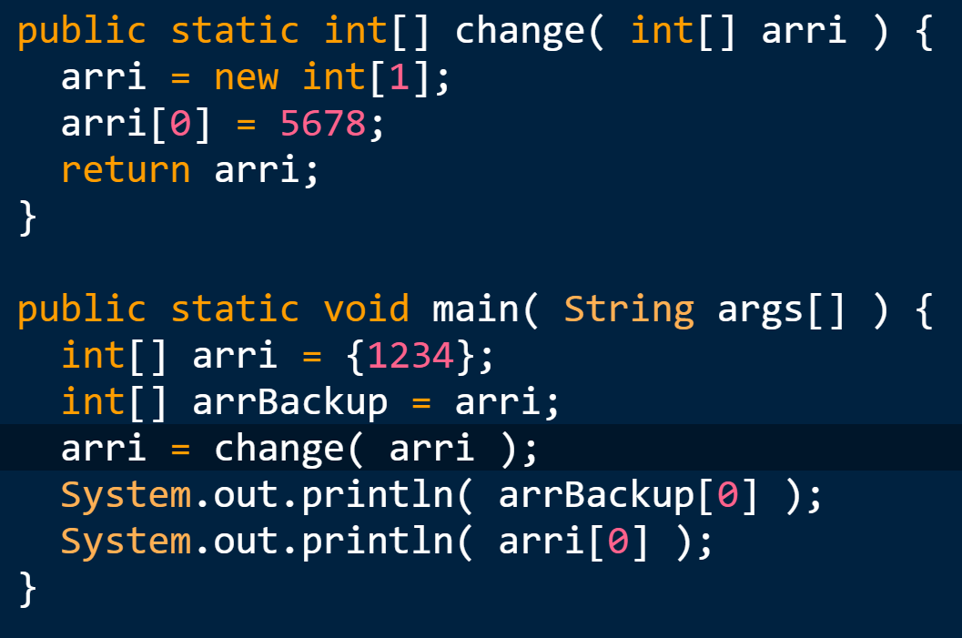
PART 3: NON-PRIMITIVES - REF VALUE RETURN
The fix:
Add a return
Assign the return
Note: If you still have a handle on the old copy, there are 2 objects floating around now

Slide 20
PART 3: NON-PRIMITIVES - IN CONCLUSION
Alright, we're feeling pretty good about argument and return passing
- It is ALWAYS pass by value
- For non-primitives, the value just happens to be a reference value
Notes:
But what if we don't want to just print numbers to the console? Reading from an array is very much like writing to it; we can just specify both the array to read from and an index... Then we may handle the resultant value like we would any other element of that data type. This is why printing from arrays works; because Java handles the array contents as ints, and ints can be readily printed.

Slide 21
PART 4:
STRINGS
TLDR:
Still passed by reference value
Strings are immutable
Doesn't behave like we expect a reference value pass because of immutability

Slide 22
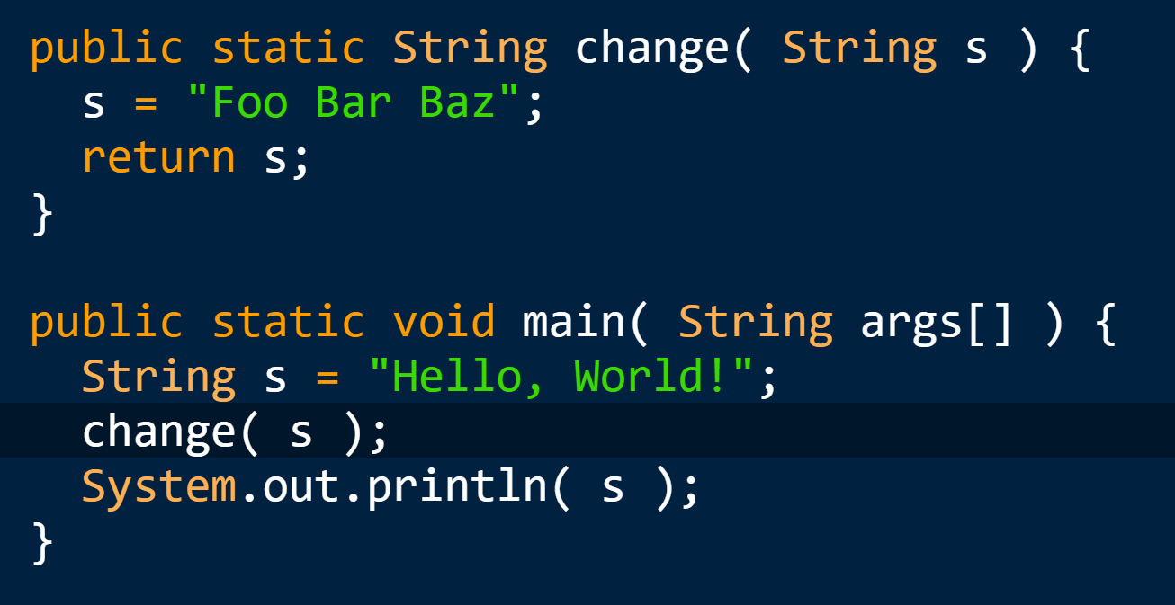
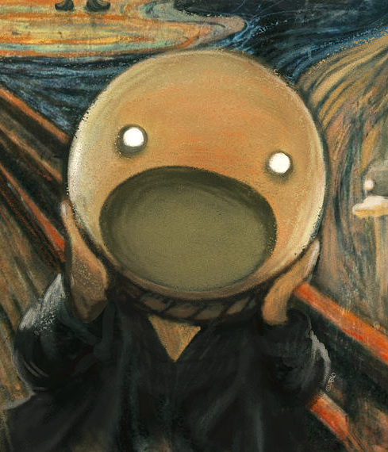
PART 4: STRING PASSING
1) String is a non-primitive
∴ Pass by reference value
2) "Foo Bar Baz" assigned to 's'
∴ 's' points to "Foo Bar Baz"
3) 's' in caller is not reassigned
∴ Doesn't usually matter
because… references
Soooo....
What happens?
CONSOLE:
Hello, World!
Notes:
If we then wish to access a range of elements from an array, we may now iterate across it using a for loop. The output from this code snippet should appear as follows:

Slide 23

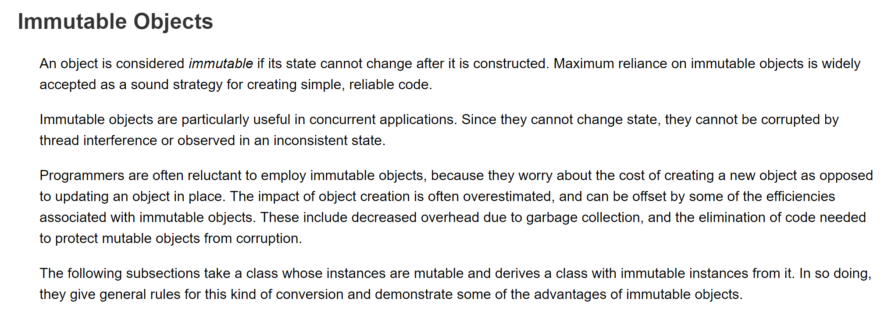
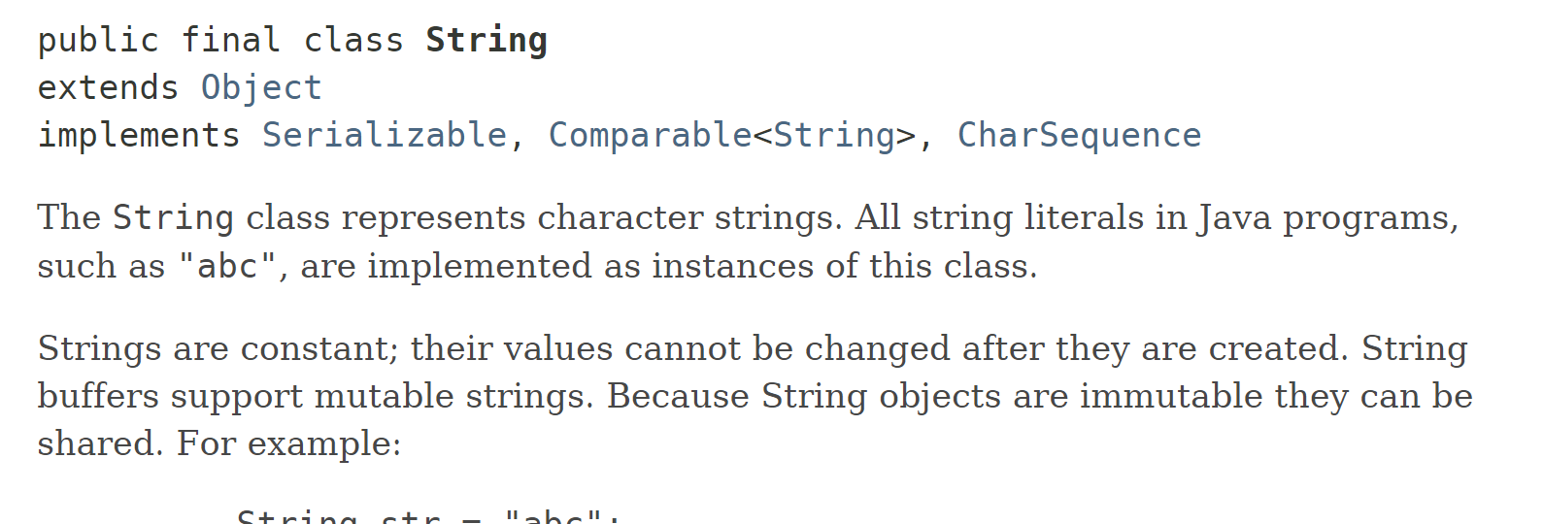
PART 4: WHAT IS A STRING?
A String is type of object called 'immutable objects'
- 'char' array (char[])
- Can't be modified after construction
https://docs.oracle.com/javase/tutorial/essential/concurrency/immutable.html
https://docs.oracle.com/javase/9/docs/api/java/lang/String.html
Notes:
If we then wish to access a range of elements from an array, we may now iterate across it using a for loop. The output from this code snippet should appear as follows:

Slide 24
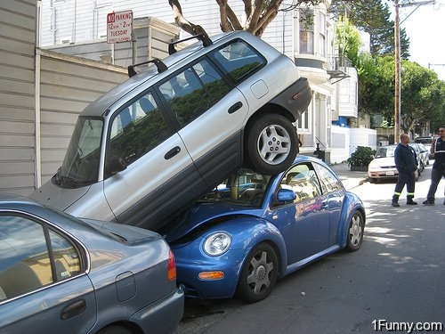

PART 4: IMMUTABLE OBJECT ASSIGNMENT
Impossible to correct a mistake
Once created, the state of the immutable object cannot be changed.
You can just try again somewhere else, though.
Notes:
If we then wish to access a range of elements from an array, we may now iterate across it using a for loop. The output from this code snippet should appear as follows:

Slide 25
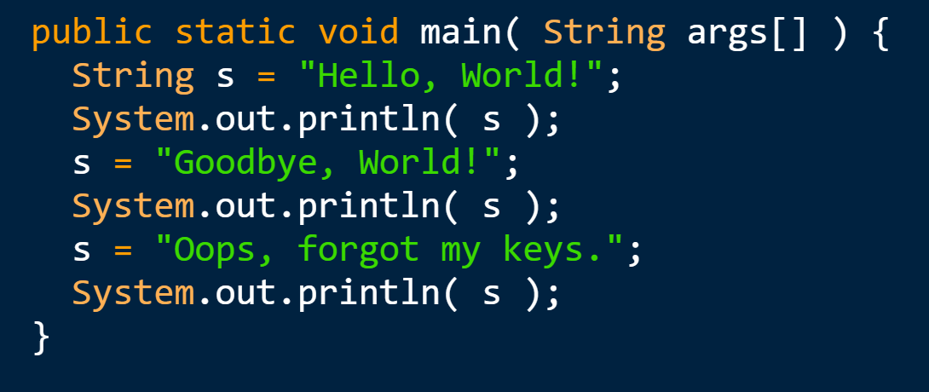
PART 4: IMMUTABLE OBJECT ASSIGNMENT
Looks like the object at 's' changes but in actuality...
Generates 3 separate references
- "Hello, World!"
- "Goodbye, World!"
- "Oops, forgot my keys."
On assignment, the reference value of 's' changes, while the char arrays representing the strings at each location do not.
CONSOLE:
Hello, World!
Goodbye, World!
Oops, forgot my keys.
Notes:
If we then wish to access a range of elements from an array, we may now iterate across it using a for loop. The output from this code snippet should appear as follows:

Slide 26
PART 4: STRING PASSING
1) String is a non-primitive
∴ Pass by reference value
2) "Foo Bar Baz" generated at a new memory location and its reference is assigned to 's'
∴ 's' points to "Foo Bar Baz"
3) 's' in caller is not reassigned
∴ Still points to "Hello…"
Soooo....
The object at the original reference location has not changed and will display "Hello, World!"
CONSOLE:
Hello, World!
Notes:
If we then wish to access a range of elements from an array, we may now iterate across it using a for loop. The output from this code snippet should appear as follows:

Slide 27
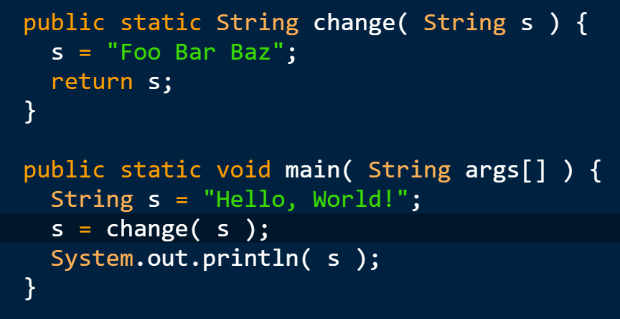
PART 4: STRING PASSING - THE FIX
None! Treat it just like passing by value and remember to assign the return.
CONSOLE:
Foo Bar Baz
Notes:
If we then wish to access a range of elements from an array, we may now iterate across it using a for loop. The output from this code snippet should appear as follows:

Slide 28
PART 4: STRING PASSING - THE GOTCHA
Because strings cannot be changed:
- Every assignment creates a new string
- Every variant or concatenation creates a new string
- Repetitive actions on large strings can strain system resources quickly
Use care when handling immutable objects!
Notes:
If we then wish to access a range of elements from an array, we may now iterate across it using a for loop. The output from this code snippet should appear as follows:

Slide 29

Questions? Queries?
Tim (Tea) Lum
twhlum@gmail.com
linkedin.com/in/Teabeans
Slack: https://join.slack.com/t/uwb-hibernaculum/signup
Test code at: https://github.com/Teabeans/UWB/blob/master/TA/Demo_Lesson_2019.java Outputs at: https://github.com/Teabeans/UWB/blob/master/TA/Demo_Lesson_output_2019.txt Course TA log: https://teabeans.github.io/css142_TA.html
Notes:
Thank you for your time and attention! Please note the following resources for your use including the class/cohort Slack channel, test code, a course calendar, and a running question log. Are there any questions?

